Slide 1





AI PROJECTS

Slide 2



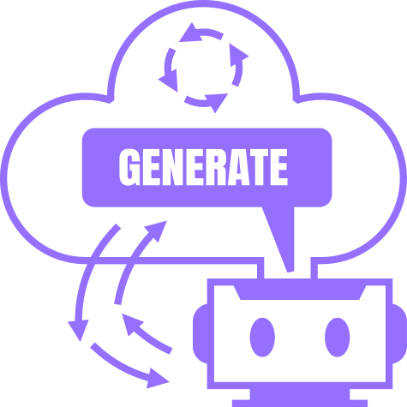





GEN-AI PROJECTS
SENTIMENT-ANALYSIS
FOOD RECOGNITION
TEXT-TEXT PROJECT
IMAGE-TEXT PROJECT

Slide 3
SENTIMENT ANALYSIS
TEXT-TEXT MODEL

Slide 4




SENTIMENT ANALYSIS
PROJECT GOALS
Classify Sentiments
Bilingual Support
User-friendly Interface
Automatically identify and classify the sentiment of user-provided input as positive, neutral, or negative.
Provide sentiment analysis in both English and Arabic
Provide an easy-to-use interface for users to input a file and receive immediate sentiment results.

Slide 5



SENTIMENT ANALYSIS
TOOLS USED
Gradio Interface
Python
Transformers
Gradio
Pandas
Hugging face Pipelines
Matplotlib

Slide 6

SENTIMENT ANALYSIS
MODEL CHOICES
CAMeL-Lab/bert-base-arabic-camelbert-da-sentiment for Arabic sentiment analysis.
distilbert-base-uncased-finetuned-sst-2-english for English sentiment analysis.
We chose these models because they are pre-trained on extensive datasets, The English model, distilBERT, is known for its smaller size and faster performance, For Arabic, the CAMeL-Lab model is specifically fine-tuned for Arabic language, providing more precise sentiment detection in Arabic text.

Slide 7

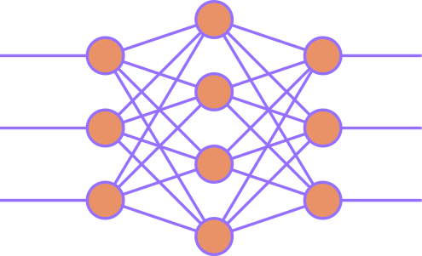


SENTIMENT ANALYSIS
PROJECT WORKFLOW
INPUTS
MODEL
Outputs
MODEL SELECTION
RESULTS
The user get to choose the Language and upload a file that contains sentences to be classified
The project uses a sentiment-analysis model to classify the sentences
A table that contains the classified sentences along with a distribution bar plot

Slide 8
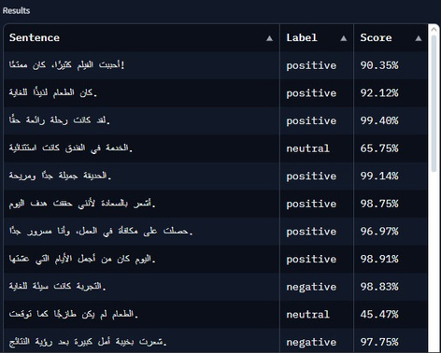
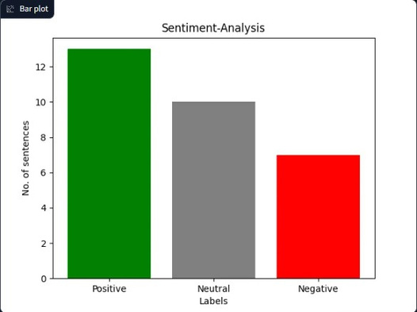
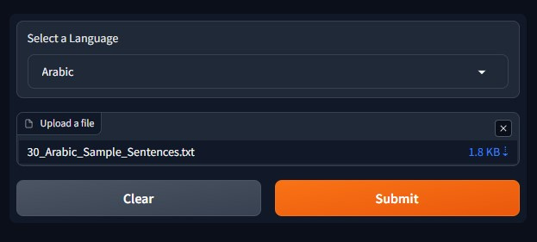
SENTIMENT ANALYSIS
ILLUSTRATIVE EXMAPLE
Outputs
INPUTS
A table that contains the classified sentences along with a distribution bar plot
The user get to choose the Language and upload a file that contains sentences to be classified
Classifies Inputs

Slide 9
FOOD RECOGNITION & NUTRITION
IMAGE-TEXT MODEL

Slide 10

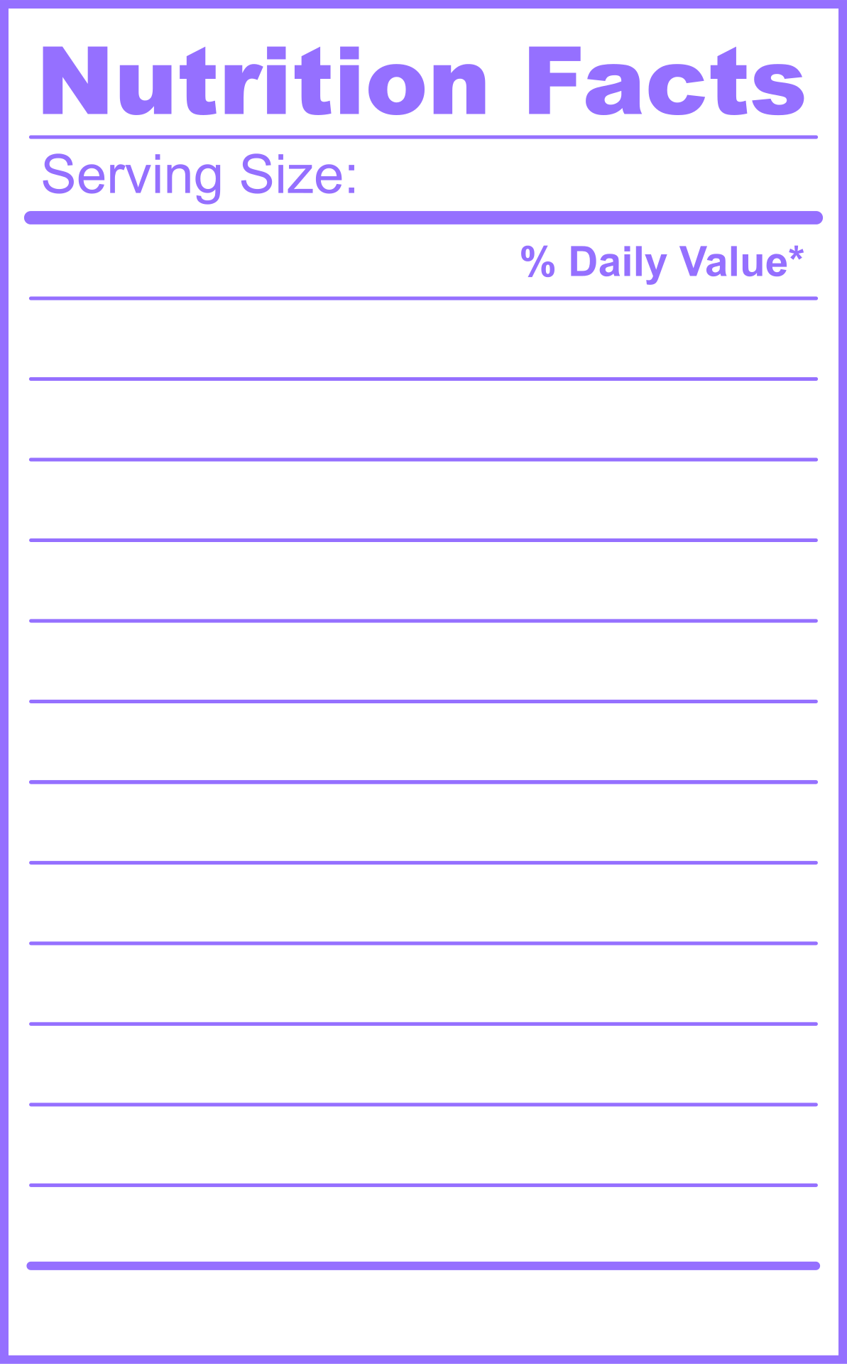

FOOD RECOGNITION & Nutrition Info
PROJECT GOALS
Food Recognition
Nutritional Data
Bilingual Output
Implement an AI system that recognizes various food items from images using advanced visual question-answering models.
Provide users with detailed nutritional data (calories, protein, carbs, sugars, fiber, sodium, fat) in an easy-to-read format.
Present nutritional details in both English and Arabic to serve a wider user base.

Slide 11
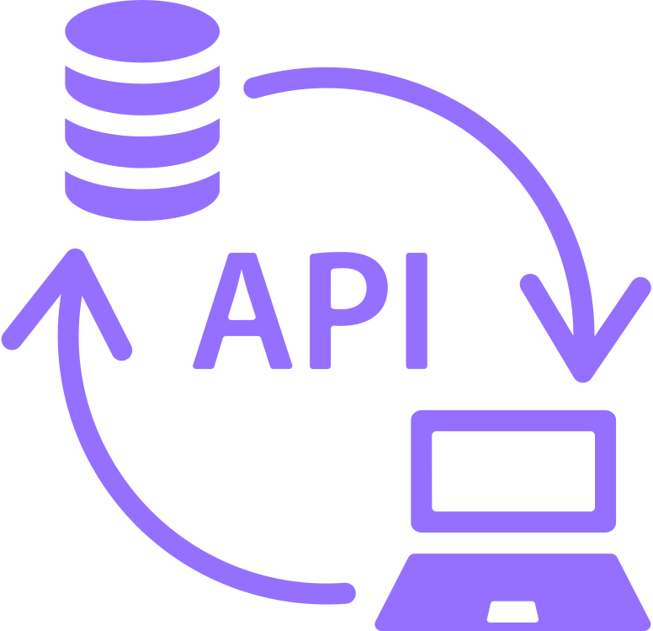
FOOD RECOGNITION & Nutrition Info
TOOLS USED
Gradio Interface
Python
Transformers
Gradio
requests
wget
Hugging face Pipelines
API
Nutritionix API

Slide 12
FOOD RECOGNITION & Nutrition Info
MODEL CHOICES
Salesforce/blip-vqa-base
for Visual Question Answering (VQA).
marefa-nlp/marefa-mt-en-ar
for English-to-Arabic translation.
The blip-vqa-base model was selected because it’s specifically trained for visual question answering, making it well-suited for identifying food items in images, the marefa model is used to provide a translation from English to Arabic. Unlike some other translation models (e.g., Helsinki-NLP), which are primarily optimized for full sentences, this model effectively handles both individual words and short phrases.

Slide 13

FOOD RECOGNITION & Nutrition Info
PROJECT WORKFLOW
INPUTS
MODEL
API
Outputs
What is the food in the image
Food item
Results
The user get to choose the Language and upload an image of the food
The project uses a Visual Question Answering (VQA) model from to recognize the food items in an uploaded image
The Nutritionix API receives the detected food item and searches its extensive database to retrieve detailed nutritional information
A text box displays the name of the detected food along with its nutritional data

Slide 14
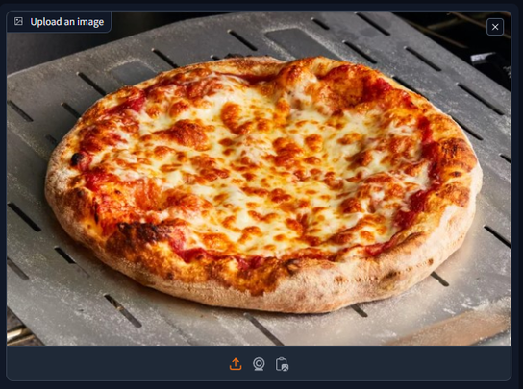

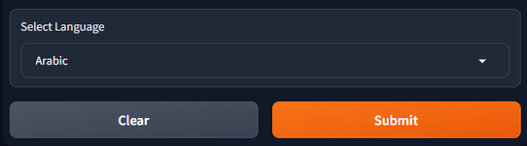
FOOD RECOGNITION & Nutrition Info
ILLUSTRATIVE EXAMPLE
INPUTS
Outputs
The user get to choose the Language and upload an image of the food
A text box displays the name of the detected food along with its nutritional data
Inputs processing

Slide 15
EXPLORE THE PROJECTS
Sentiment-Analysis
Food Recognition & Nutrition Info
Github.
Github.
Hugging Face.
Hugging Face.

Slide 16


